Slide 1


DATA SCIENCE
UNIT 2- Use Cases and Performance
Evaluation
Presented by:
Sachin Saxena
SME, upGrade

Slide 2
2.1 Data Science Use Cases (DSUCs)
Identifying DSUCs and their Value propositions
Identification of an Organizations’s Use Cases Illustration
Value Propositions of applying data science tools – Three figures
Learning the Data Set and Prediction Model
Making Predictions and Decisions
Machine Learning Canvas (Dorard, 2017)

Slide 3
2.1 Data Science Use Cases (DSUCs):
Pivotal Data Labs planned to use data science to understand TV show viewer habits and preferences to help with the formulation of the next series of these TV shows. According to a case study published by Pivotal, the challenge was handling the huge amount of broadcast data, much of which had to be manually collected. Therefore, Piv- otal built an in-database data processing model that incorporates all data into a sim- ple format that is easy to navigate. The value of the model developed by Pivotal the clear perspective on what variables affect a show’s popularity, as well as viewer prefer- ences for a certain show over the lifespan of that show. The model helps broadcasting clients make informed decisions based on a robust approach that was previously unavailable.

Slide 4

2.1 Data Science Use
Cases (DSUCs):

Slide 5
2.1 Data Science Use Cases (DSUCs):
Use cases and scenarios show business managers the benefits data science tools can offer for enhancing decision-making within their organizations. Once a data science use case (DSUC) is identified and a prediction model developed, the performance of the model must be evaluated and its effectiveness in helping businesses reach their goals measured. But, attention must also be paid to the cognitive and motivational biases that might impact model inputs, thus influencing the model’s performance and, consequently, an organization’s decision-making. All these aspects will be discussed in this unit.

Slide 6


Use Case: 1
ChatGPT
“a cat with Santa dress”

Slide 7
Identifying DSUCs and their Value propositions
The real value of a business is unlocked through in-depth investigation of its collected data. Organizations must not only overcome the challenges inherent in managing this data but also identify the right DSUC for their business objectives. A well-matched DSUC will give managers valuable insights for addressing business challenges and improving future gains. The DSUCs which apply prediction techniques to extract value from collected data can vary widely across organizations. In general, however, a DSUC in any business is identified through three main aspects: achieved value, effort, and risk. Managers tend to measure a potential new project by how much it could improve their operational business and/or bottom line. The analysis of an organization’s business should therefore focus on increasing gain, reducing risk, and/or decreasing effort.

Slide 8
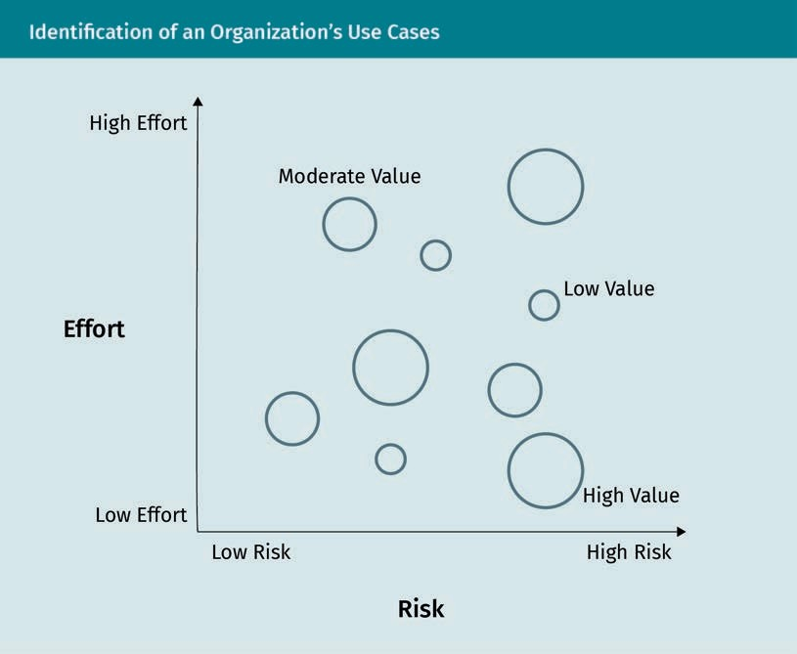
Identification of an Organizations’s
Use Cases Illustration
What is the value of the knowledge gained from applying data science tools to the dataset?
What will be learned about the dataset?
What will be learned about the hypothesis the data science tools will test?
What will be the value of that knowledge if the prediction model developed shows good business performance? If it shows a negative business outcome?

Slide 9
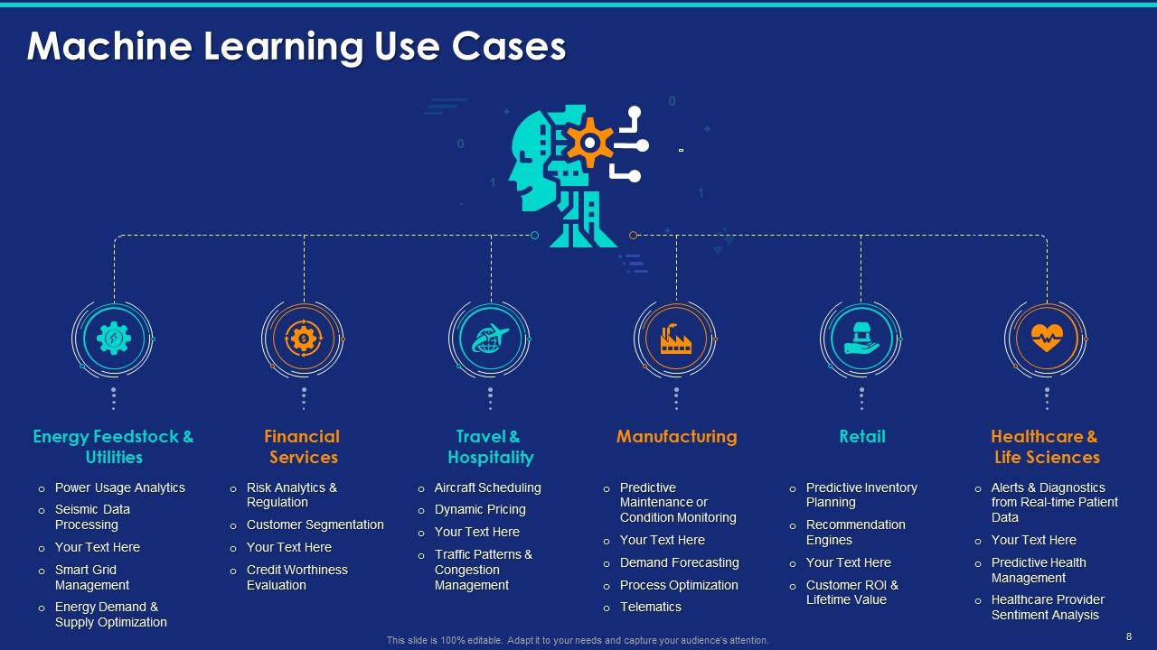

Slide 10
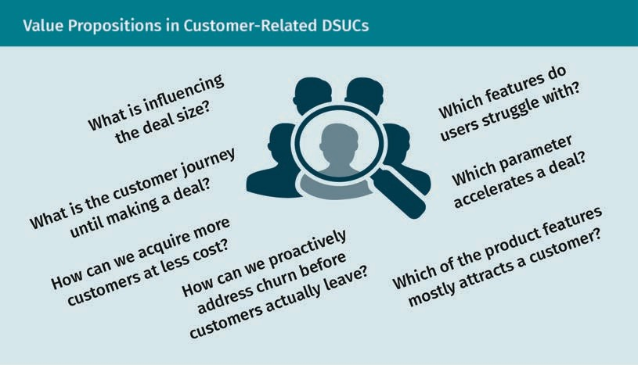
Value Propositions of applying data science tools – Three figures

Slide 11
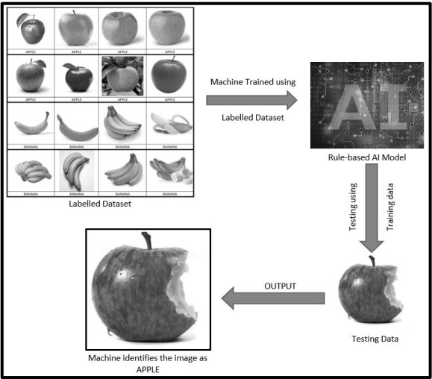
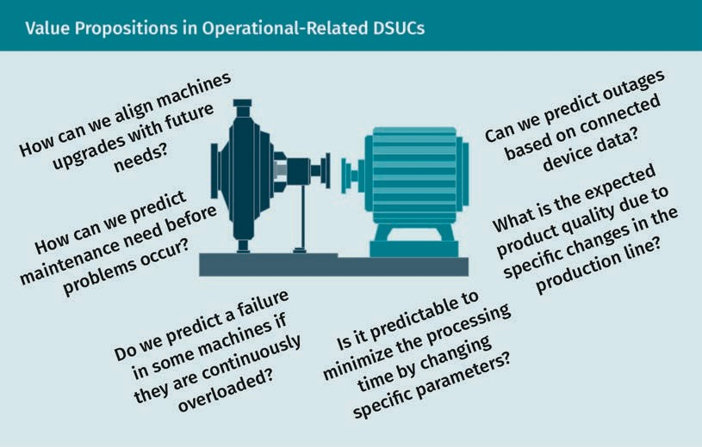
Value Propositions of applying data science tools

Slide 12

2.1 Data Science Use Cases (DSUCs):
Use Case: 2:
Scroobly - Scrooble a doodle. Bring it to life.

Slide 13
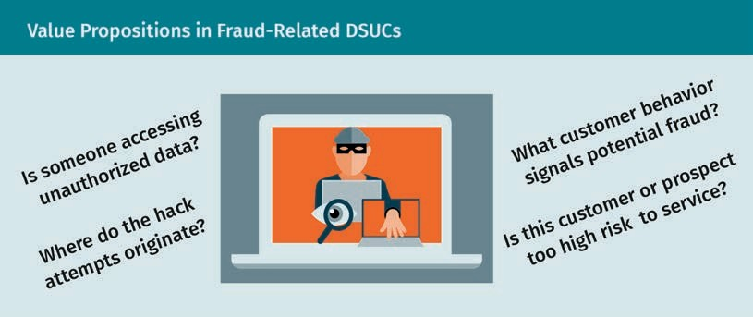
Value Propositions of applying data science tools – Three figures

Slide 14
Learning the Data Set and Prediction Model
Once a DSUC is identified, the relevant dataset needs to be collected from the available data sources (or new data sources built). Types of data sources include internal/external databases, sensor data, static files, and Web scraping. The data collection process may be expensive if humans are required to study the data and manually insert important tags, labels, and/or valuable comments.

Slide 15
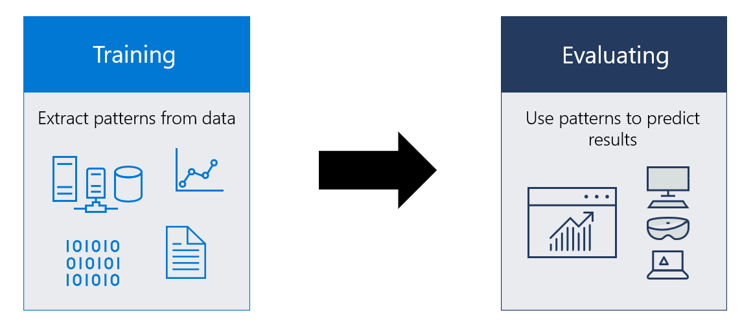

Slide 16
Learning the Data Set and Prediction Model
The collected dataset is forwarded to preprocessing where it is scrubbed of any noise and scanned for redundant records and missing values. Cleaning data typically requires significant domain knowledge to make decisions about the best method to deal with errors in the data. At the end of the preprocessing stage, the representative size of the dataset will have been reduced and misleading information removed. A dataset will contain variables (i.e., features) with numerical, categorical, and/or textual values. Certain features may not be relevant to or compatible with the desired DSUC values. Therefore, features should be carefully selected such that they can be used to deter- mine output value propositions.

Slide 17
Learning the Data Set and Prediction Model
Once a DSUC is identified, the relevant dataset needs to be collected from the available data sources (or new data sources built). Types of data sources include internal/exter- nal databases, sensor data, static files, and Web scraping. The data collection process may be expensive if humans are required to study the data and manually insert impor- tant tags, labels, and/or valuable comments.

Slide 18
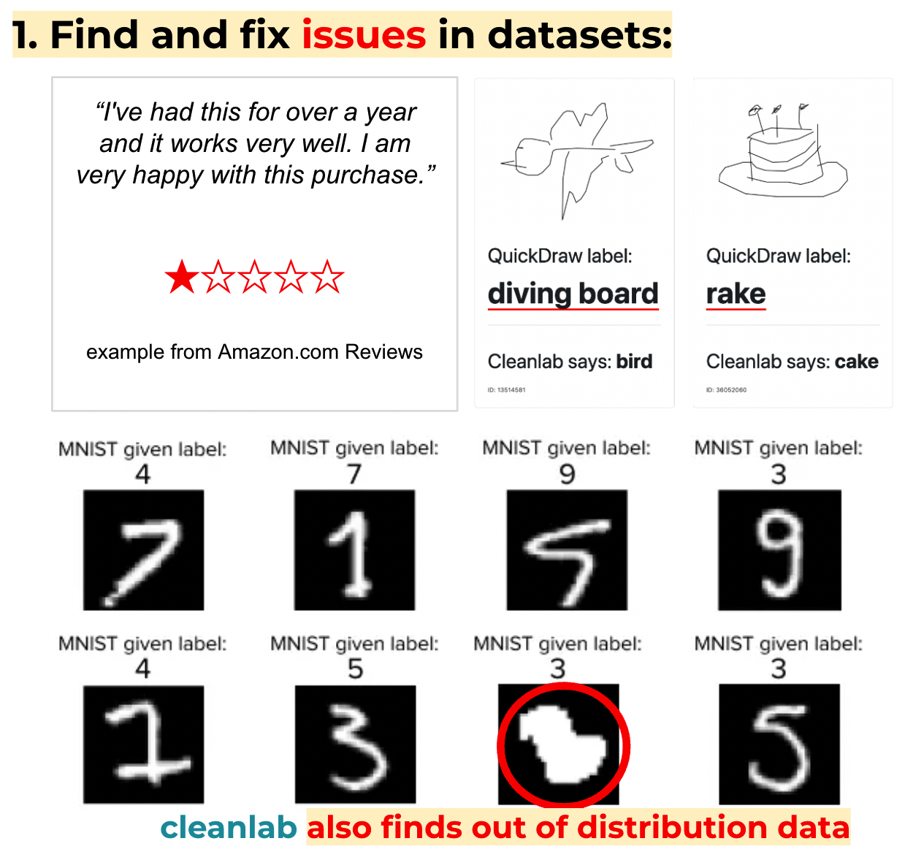

Slide 19
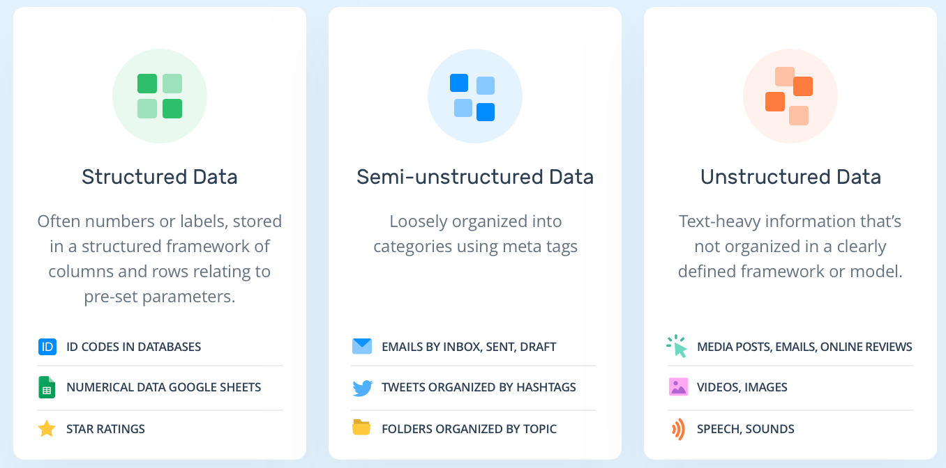

Slide 20
Learning the Data Set and Prediction Model
There are many numerical approaches which have been established for learning data- sets and building robust prediction models, namely machine learning approaches.
These approaches depend on the nature of the dataset’s outputs. Classification approaches are used if the outputs are to be categorized into classes (e.g., {sunny, windy} for weather datasets), and regression approaches are used if the outputs are probability density distributions (e.g., {profits} for customer purchasing datasets).

Slide 21
2.1 Data Science Use Cases (DSUCs):
Use Case: 3
Experiments in Handwriting with a Neural Network (distill.pub)

Slide 22
Making Predictions and Decisions:
Once the prediction model has been built, it is ready to find the function which relates selected features of the data (inputs) to the objective value of the DSUC (output). Itera- tions of the model may need to be run several times until it produces a reasonably high level of accuracy with respect to the testing set. The output of a prediction model is either a probability (for a classification model) or a probability density distribution and/or a number with a degree of uncertainty (for a regression model). For classifica- tions, determining the model’s accuracy requires a threshold to be set on the model’s output (e.g., transactions with a probability higher than 80 percent are flagged as fraud). For regressions, an optimal point estimator needs to be determined from a pre- dicted probability distribution (e.g., error between predicted output and target output is less than five percent).

Slide 23
Making Predictions and Decisions
For example, in the case of fraud analysis, the outputs of the prediction model are fraud probabilities. The decision about which model threshold to choose is a strategic one that will impact the identification of fraud/non-fraud cases. A low threshold will result in more cases being incorrectly identified as fraud, while a high threshold will result in the under-identification of actual fraud cases. Neither scenario is perfect— both will have incorrectly-identified cases. The question becomes which threshold is preferable for a specific use case?

Slide 24
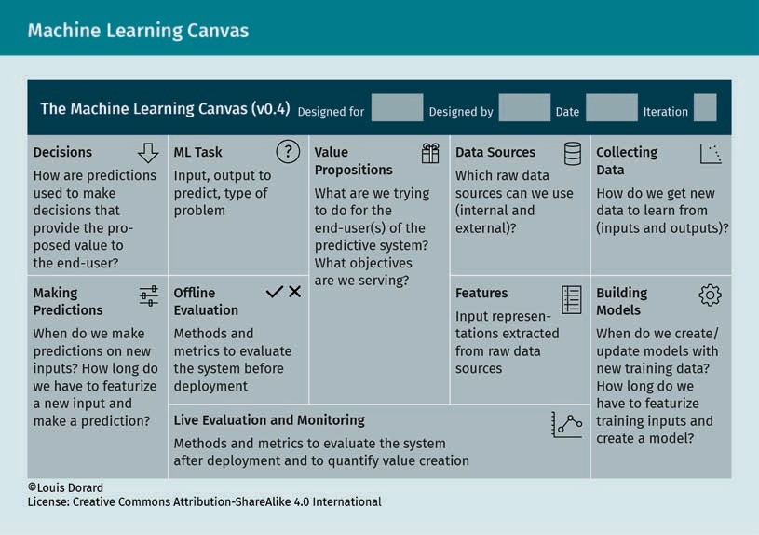
Machine Learning
Canvas (Dorard, 2017):
A helpful tool in identifying use cases is the “machine learning canvas,” developed by Dorard (2017) to provide business managers with a user-friendly work procedure.

Slide 25
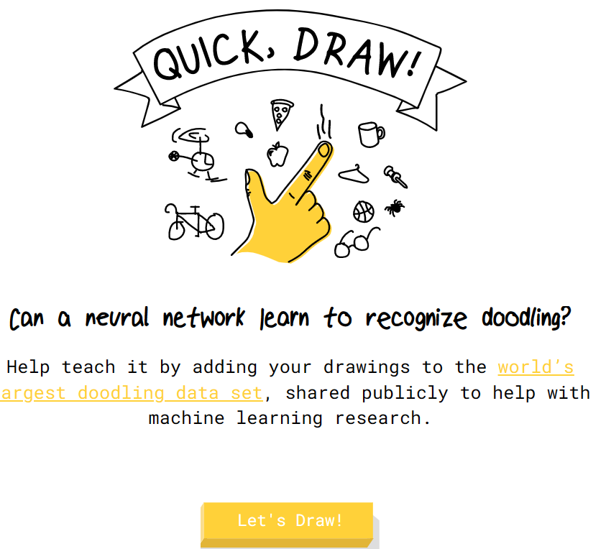
2.1 Data Science Use Cases (DSUCs):
Use Case: 4
Quick, Draw! (quickdraw.withgoogle.com)

Slide 26
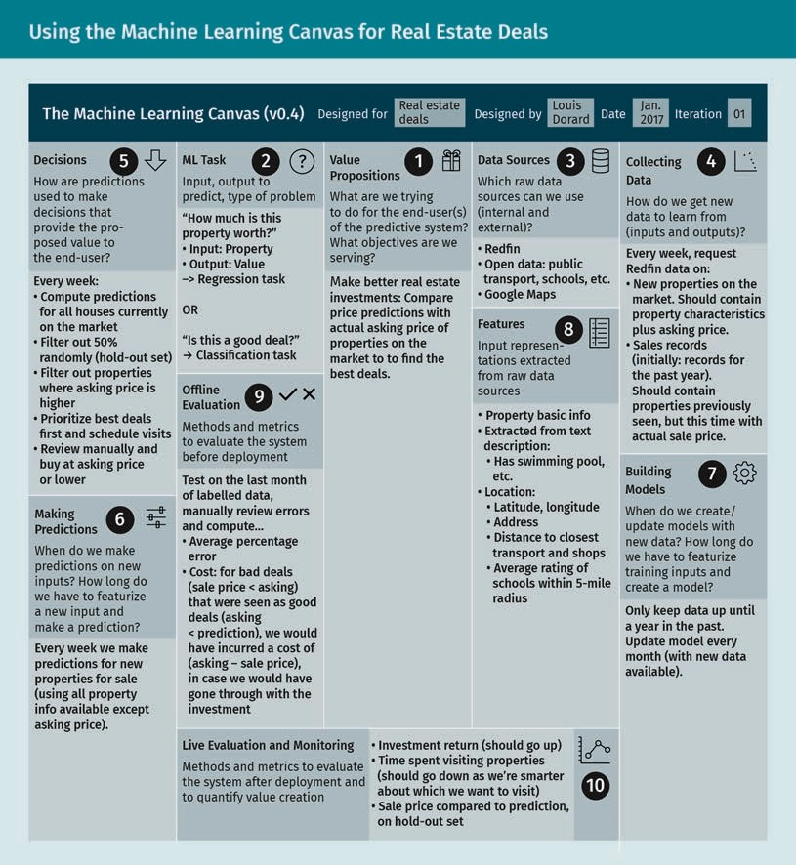
Machine Learning
Canvas (Dorard, 2017):
The tool collects in one place all the steps required to identify a use case and achieve its value proposition. For example, we can use the machine learning canvas in the case of real estate deals. Our value proposition is to make more lucrative real estate invest- ments by comparing the price predictions for properties with their actual asking prices in order to identify the best deals. The procedure of the analysis using Dorard’s machine learning canvas is summarized in the following figure.

Slide 27
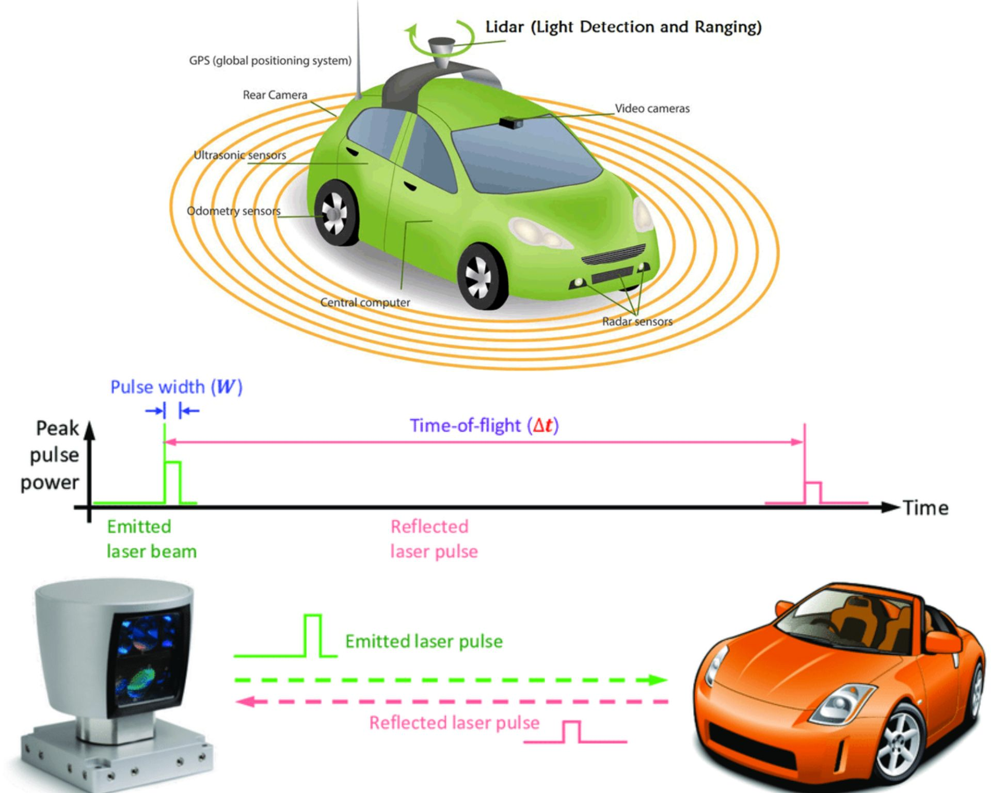
Machine Learning Canvas (Dorard, 2017)

Slide 28
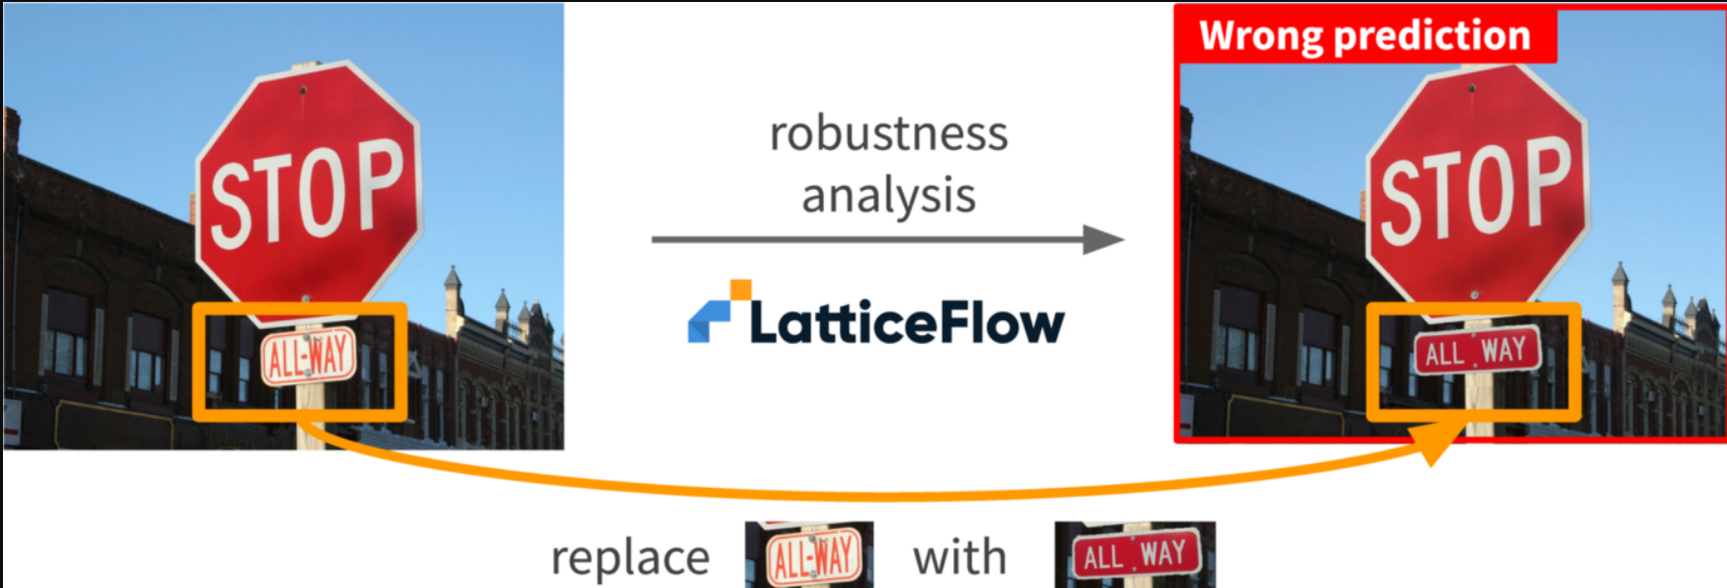
Machine Learning Canvas (Dorard, 2017)

Slide 29
2.2 Performance Evaluation
Model-Centric Evaluation: Performance Metrics
Classification model evaluation metrics
Definition and equation of Accuracy
Confusion Matrix figure
Receiver Operator Characteristic Curve
Regression Model Evaluation Metrics
Definition, Equation and examples of Absolute Error, Relative Error, Mean absolute percentage error, Square error, Mean square error, Mean absolute error, Root mean square error

Slide 30
Business-Centric Evaluation: The Role of KPIs
Characteristics of effective KPIs
Examples of KPIs
Cognitive Bias with figure
Relevant cognitive biases
Explanation of Common Cognitive and Motivational Biases
Explanation of De-biasing techniques

Slide 31
2.2 Performance Evaluation
The overall evaluation of how well a DSUC has been modeled and its predictive values applied successfully within a business can be divided into two parts. The first part involves evaluating the developed prediction model and measuring its performance through a list of known numerical metrics. The second part involves evaluating how the model’s outputs (i.e., the DSUC values) are used to better understand and improve a business. The latter is usually accomplished using a defined list of key performance indicators (KPIs).

Slide 32
Model-Centric Evaluation: Performance Metrics
In this section we discuss several metrics for measuring how well a prediction model performs its classification or regression task.

Slide 33

2.1 Data Science Use Cases (DSUCs):
Use Case: 5:
AutoDraw

Slide 34

Classification model
evaluation metrics

Slide 35
Classification model evaluation metrics:
For a classification problem with two output classes {“yes”, “no”}, the output of the pre- diction model is a probability that—depending on the set threshold—determines which class the output is assigned to. There are four possible results of a classification pre- diction model when applied to a data record: true positive (TP), false positive (FP), true negative (TN), and false negative (FN). For a TP, the classifier labels a “yes” data record as “yes,” resulting in a correct prediction. For a TN, the classifier labels a “no” data record as “no,” resulting in a correct prediction. In the case of an FP, the classifier mistakenly labels a “no” data record as “yes,” resulting in a type l classification error. And in the case of an FN, the classifier mistakenly labels a “yes” data record as “no,” resulting in a type ll classification error. This list of possible results defines an important metric for the model, called the confusion matrix.

Slide 36
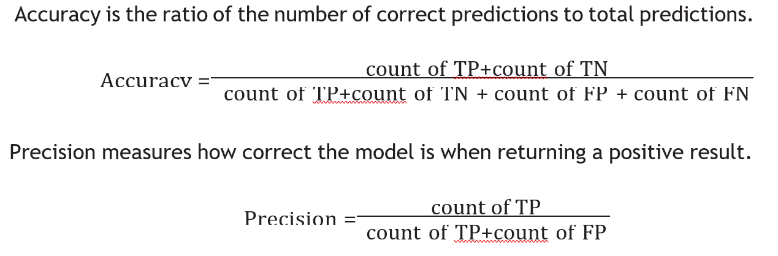
Definition and equation of Accuracy

Slide 37
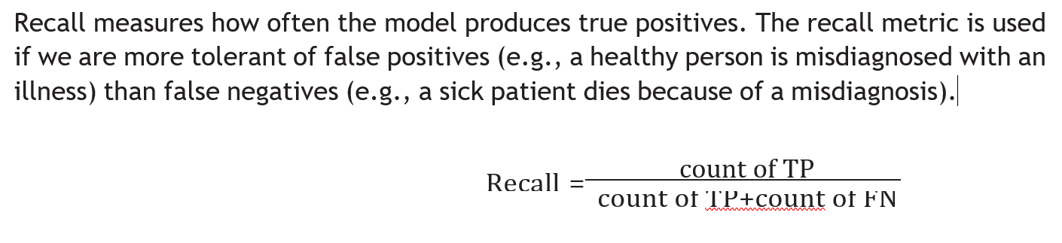
Definition and equation of Accuracy

Slide 38
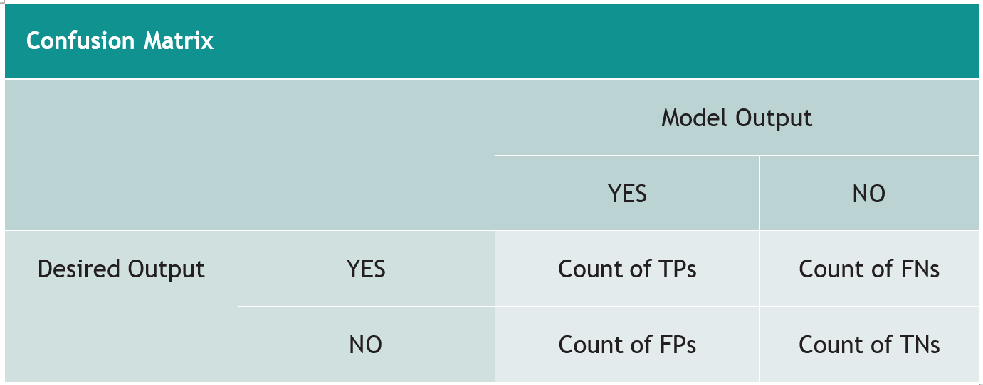
Confusion Matrix figure

Slide 39
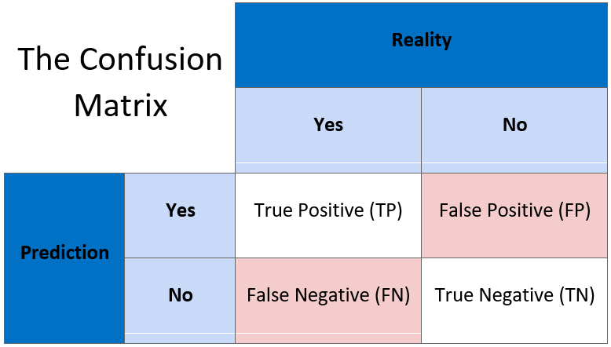
Confusion Matrix figure

Slide 40
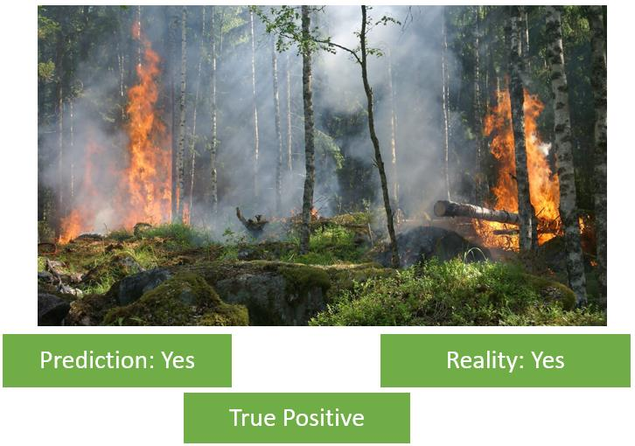
True Positive

Slide 41
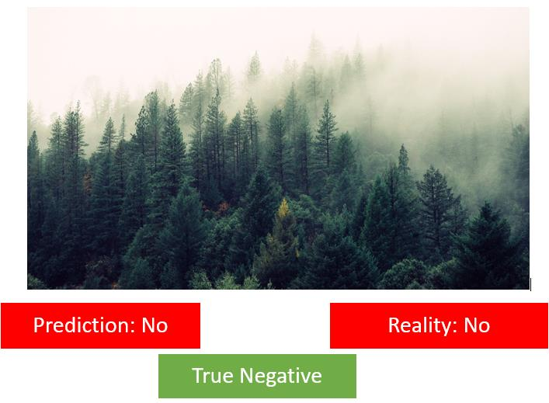
True Negative

Slide 42
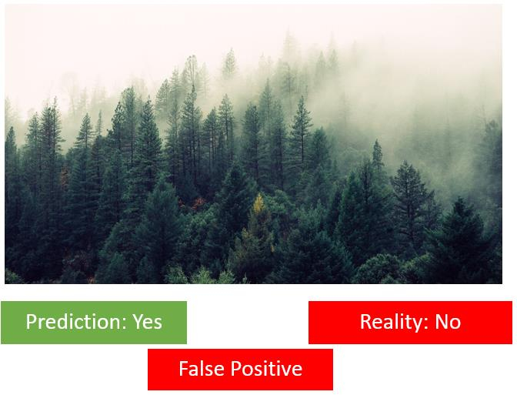
False Positive

Slide 43
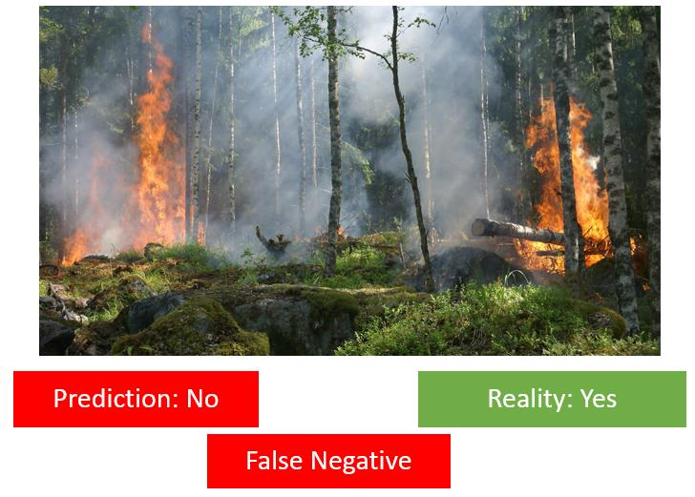
False Negative

Slide 44
Receiver Operator Characteristic Curve:
The receiver operator characteristic (ROC) curve displays the trade-off between the true positive rate and the false positive rate at every possible cutoff value. An ideal model is the one which is able to classify the testing set with a 100 percent TP rate and 0 per- cent FP rate. Therefore, the ROC curve helps find the best possible realistic cutoff value which results in the highest TP rate and lowest FP rate. An ROC curve can be generated using the following steps:

Slide 45
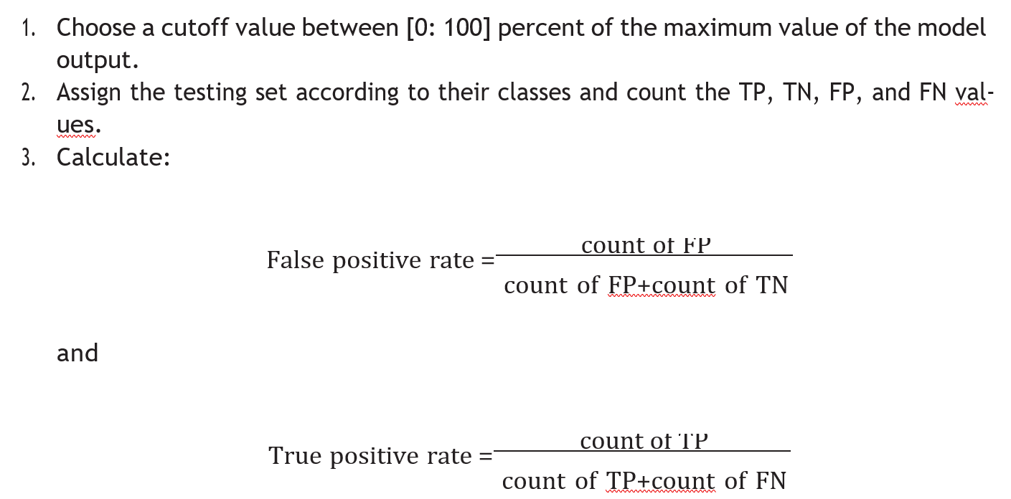
Receiver Operator Characteristic Curve

Slide 46
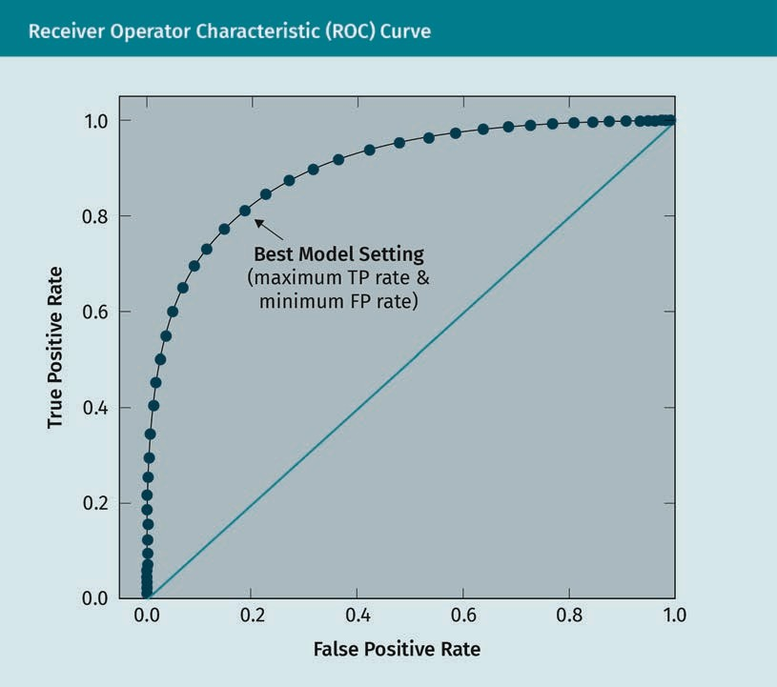
Receiver Operator Characteristic Curve :
In the ROC curve given, we notice that the closer the curve to the upper left corner, the more efficient the model (i.e., very close to the ideal model). This can be measured by calculating the area under the curve (AUC), where the AUC for an ideal model is 1.

Slide 47
Regression Model Evaluation Metrics :
The output of a regression prediction model is a probability density distribution which must be translated into a number (i.e., optimal point estimator) in order to be useful operationally. Therefore, for the testing set, the evaluation of such a model simply focuses on how close the model output (y) is to the desired output (d). The typical metrics used to evaluate the performance of a regression model are absolute error; relative error; mean absolute percentage error; square error; mean square error; mean absolute error; and root mean square error.

Slide 48
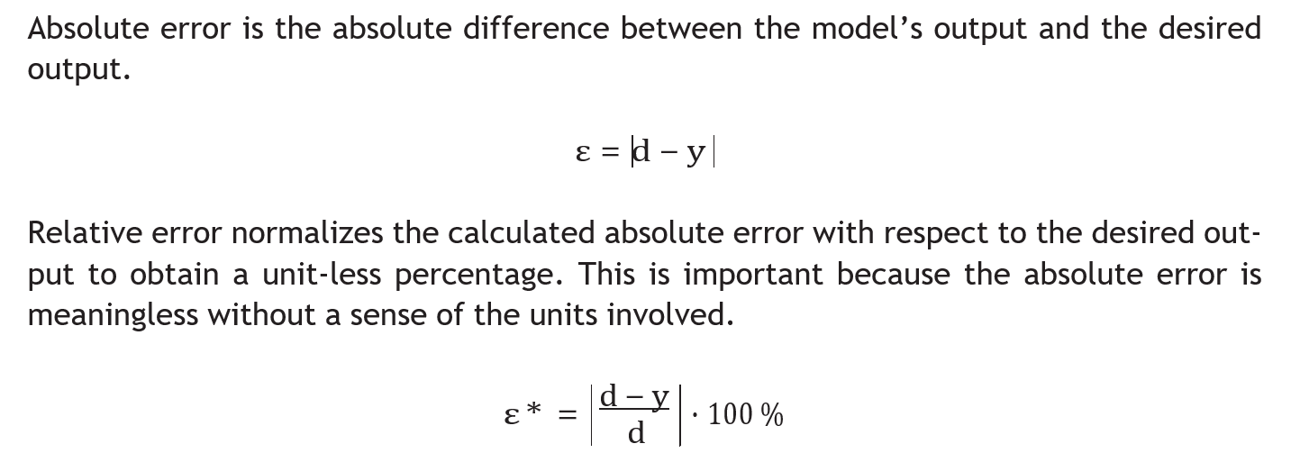
Definition, Equation and examples of Absolute Error

Slide 49
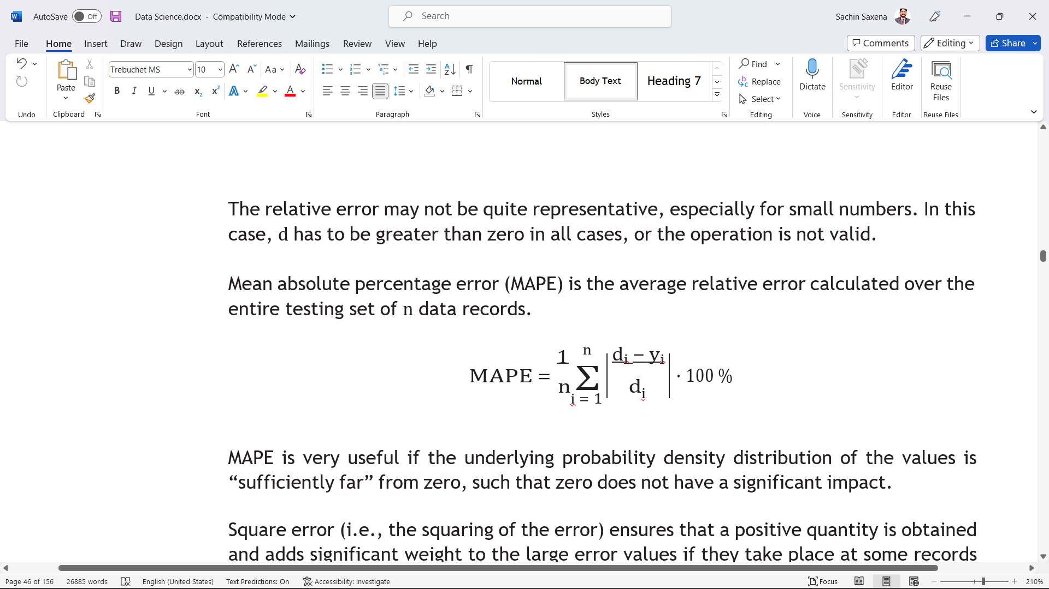
Relative Error

Slide 50
Mean absolute percentage error

Slide 51
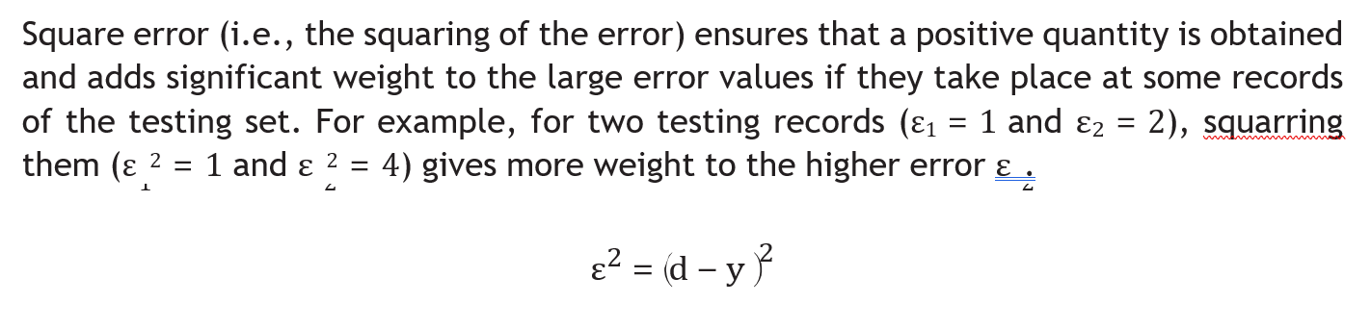
Square error

Slide 52
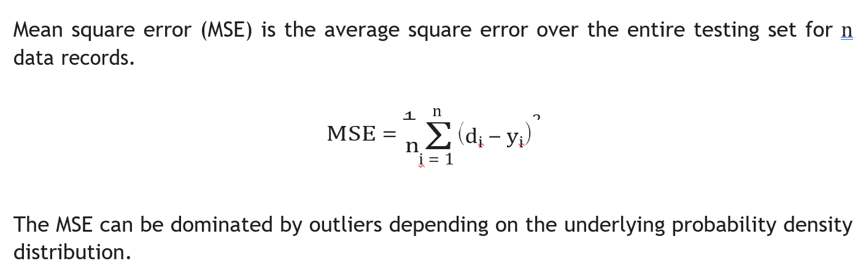
Mean square error

Slide 53
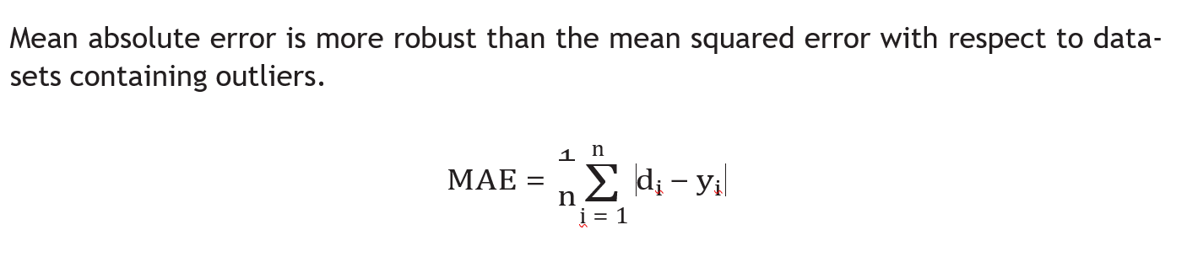
Mean absolute error

Slide 54
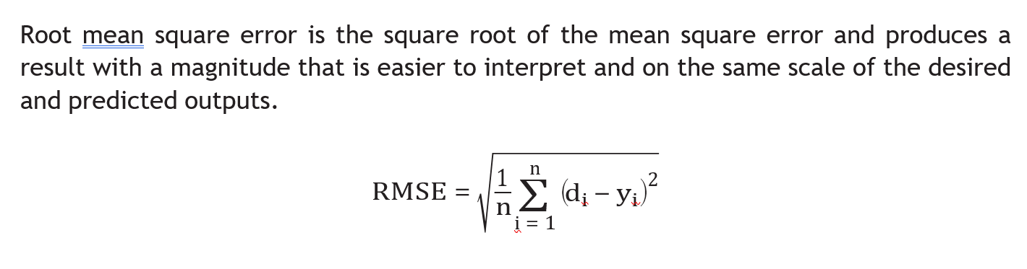
Root mean square error

Slide 55
Business-Centric Evaluation: The Role of KPIs
After the prediction model has been successfully evaluated using the above-mentioned evaluation metrics, it is ready to be implemented to produce the DSUC value for the associated business problem. Meanwhile, the end user (i.e., decision-maker) should be able to measure whether the DSUC value has been successfully implemented in their business. This evaluation is conducted using a list of key performance indicators (KPIs) to reflect how many business objectives have been achieved. Most KPIs will focus on measurements related to improving revenue, reducing costs, increasing efficiency, and/or enhancing customer satisfaction.

Slide 56
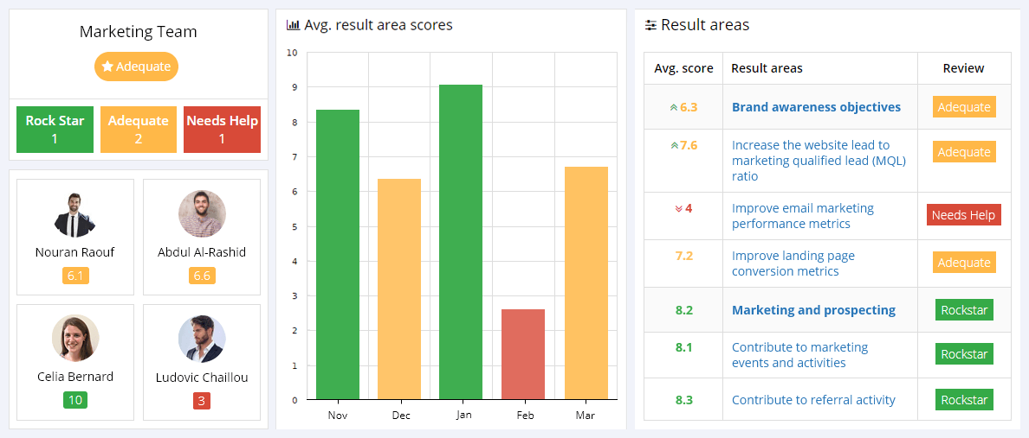

Slide 57
Characteristics of effective KPIs :
For a KPI to be truly helpful as a metric for determining business improvements and achievement of business objectives, it should be
1. easy to comprehend and simple to measure;
2. comprised of small, measurable elements (e.g., number of daily operations, amount of daily production, employee workload);
3. assigned to the appropriate, relevant task manager;
4. able to indicate positive/negative variations from the business objective;
5. achievable within the resource constraints (e.g., staff, machines, processes);
6. defined with both start and end dates for measuring; and
7. visible across the entire organization.

Slide 58
Examples of KPIs
Some examples of effective KPIs which are routinely implemented in organizations to measure DSUC performance include the following:
growth/shrinkage per year
time to finish a task
percentage of tasks completed within a specified time
cost of service delivery
machine downtime and availability
number of complaints
workload of staff
revenue per employee
production yield
employee/customer satisfaction index

Slide 59
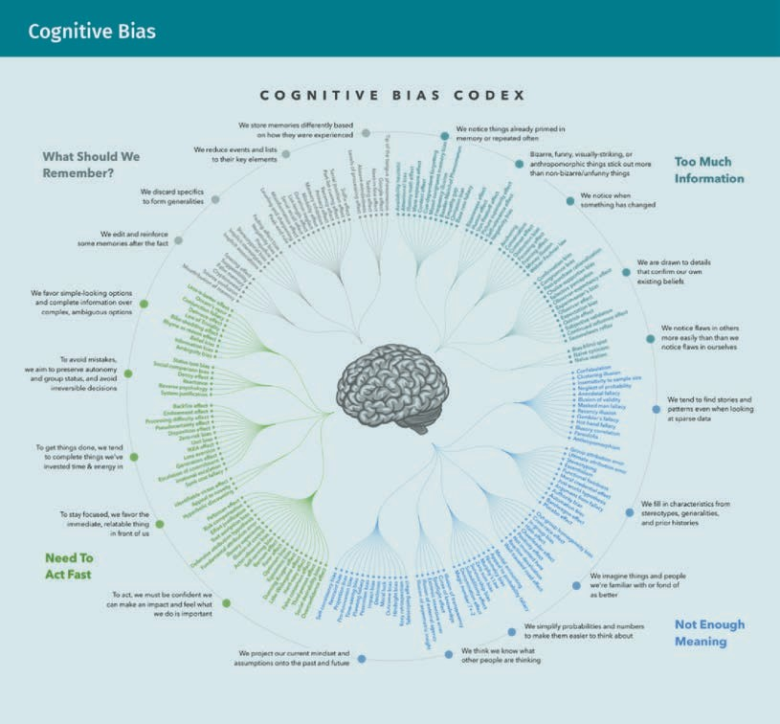
Cognitive Bias with figure
Montibeller and Winterfeldt (2015, p.1230) reported that “[b]ehavioral decision research has demonstrated that judgments and decisions of ordinary people and experts are subject to numerous biases.” In data science, the cognitive and motivational biases may be disruptive not only to the collected dataset but also at different stages of data processing. These biases seriously influence the quality of the developed prediction model. As a result, decision-making may be inaccurate. There are countless biases that are difficult to avoid, but being aware of them allows the data scientist to take them into consideration.

Slide 60
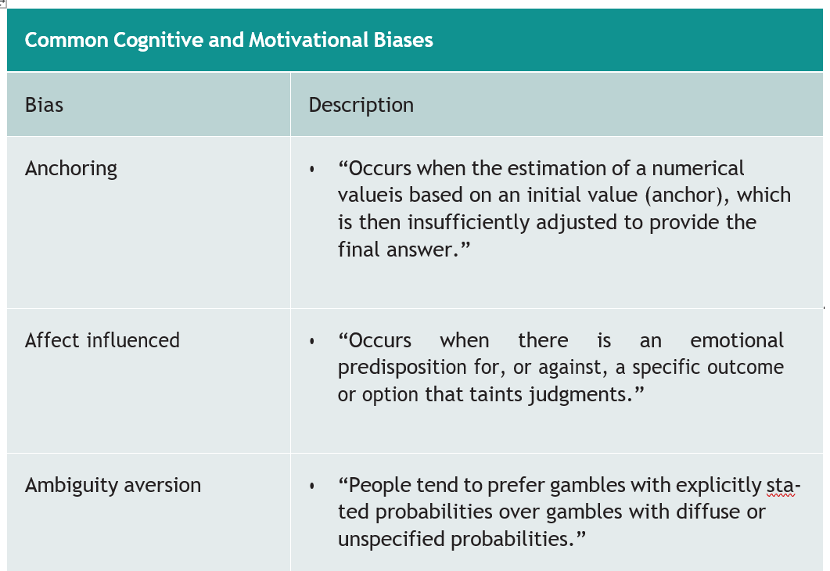
Relevant cognitive biases:
The list provided below is for the common cognitive and motivational biases that can greatly distort prediction model inputs.

Slide 61
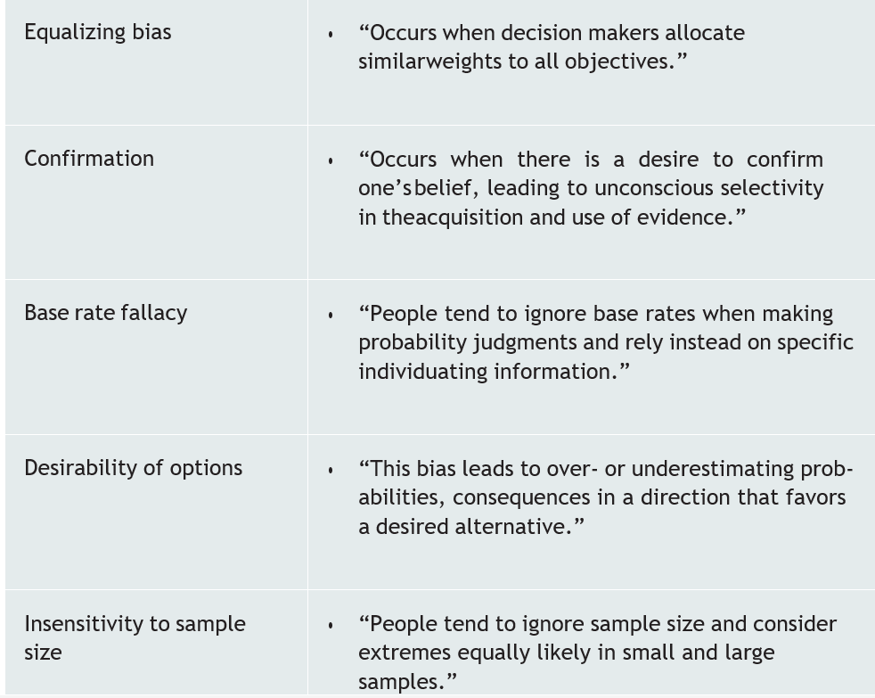
Explanation of Common Cognitive and Motivational Biases

Slide 62
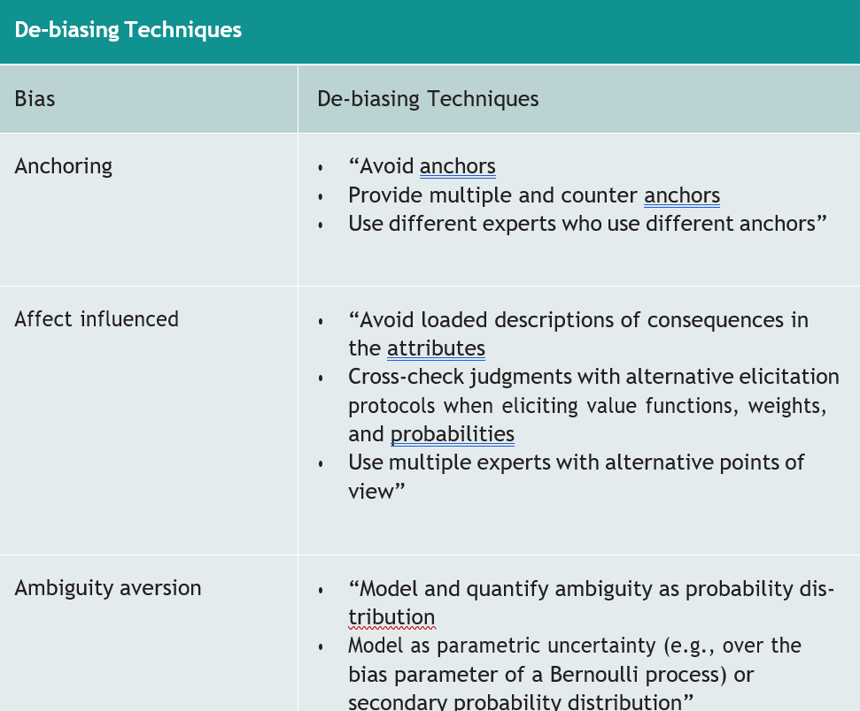
Explanation of De-biasing techniques:
De-biasing techniques attempt to eliminate, or at least reduce, the effect of the cognitive and motivational biases and avoid any related strategy- and association-based errors.

Slide 63
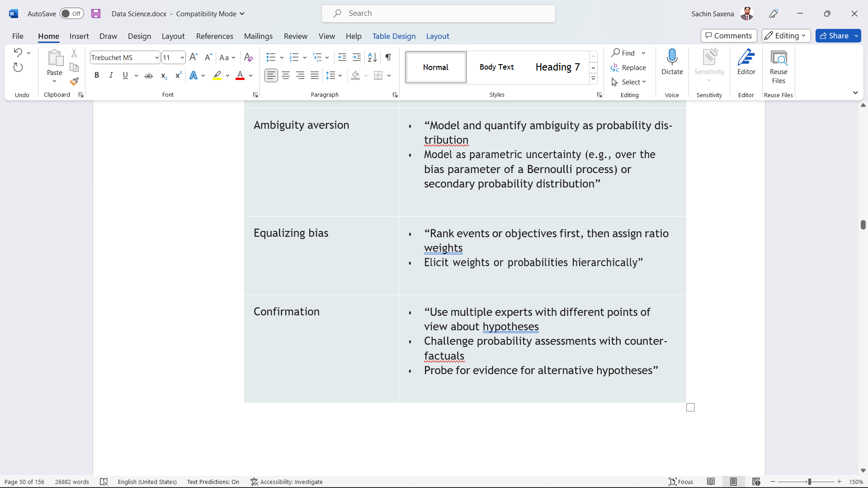
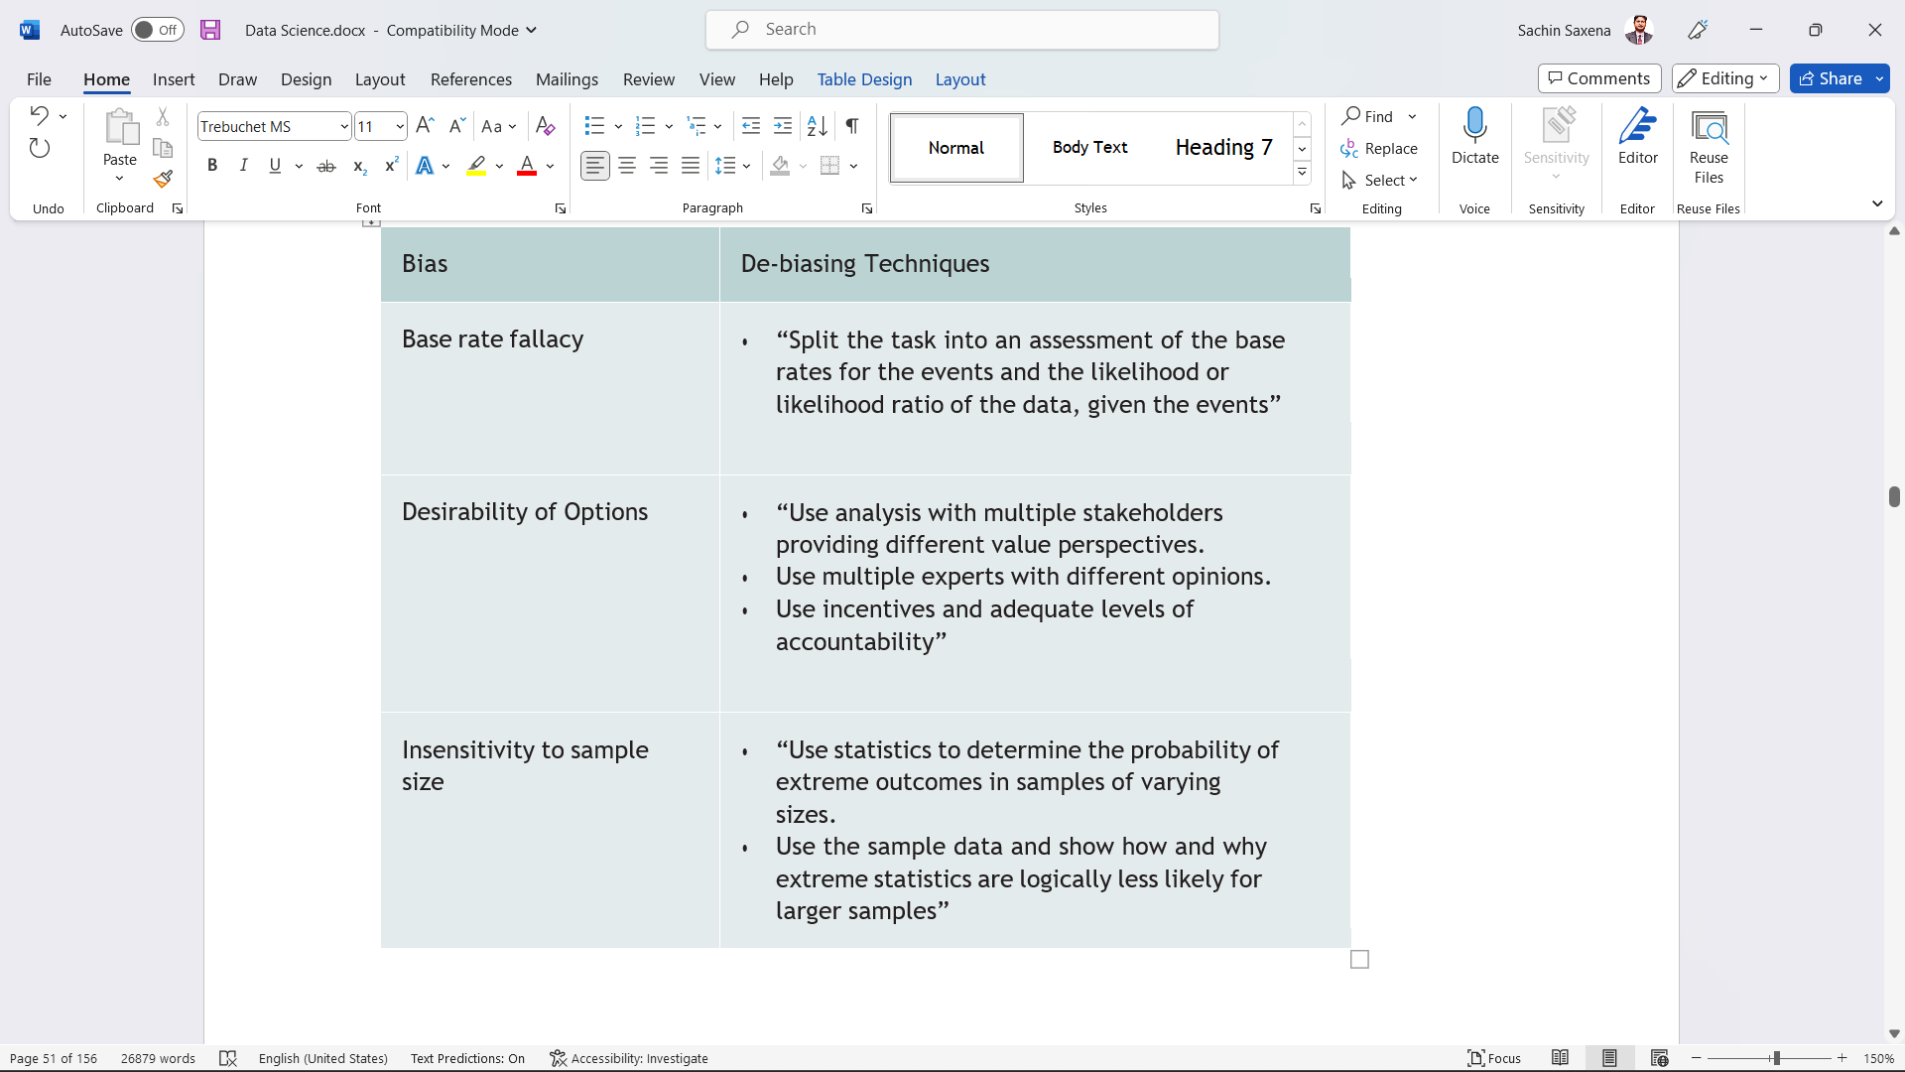
Explanation of De-biasing techniques:

Slide 64
THANK YOU

